Slide 1

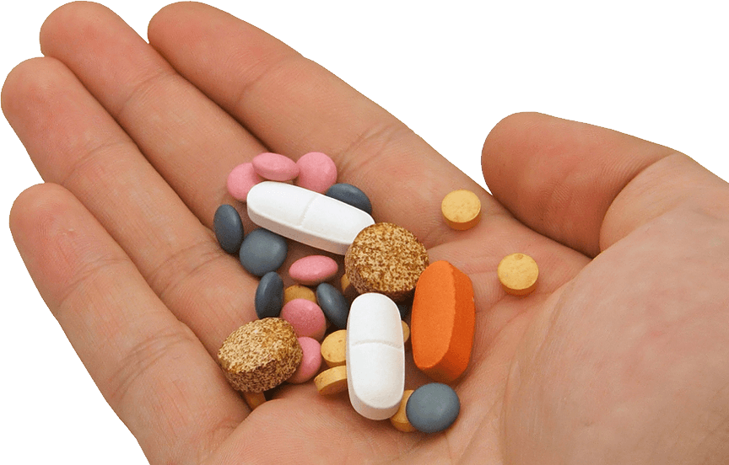
Pharmacy Management System
Ashfakur Rahman
Dept. of CSE, 12th Batch
Sylhet Engineering College, Sylhet
Reg No. 2018331524
Presented by

Slide 2

Definition & Introduction
The pharmacy management system, also known as the pharmacy information system. It is a system that stores data and enables functionality that organizes and maintains the medication use process within pharmacies.
Pharmacy Management System is robust, integrated technology. It deals with the maintenance with drugs and consumable in the pharmacy unit. The set-up of the Pharmacy Management system will ensure availability of sufficient quantity of drugs. It will design to detect drug interaction.

Slide 3
Benefits at a glance
User Friendly
Manual based System
Provides a Stable System
Paves Path for Effective Communication
Improved Efficiency
Cost-Effective Assistance
Effective Inventory Management

Slide 4
Requirements
Software Requirements :
Operating System : Windows/Linux (Not for Android)
IDE : Apache NetBeans/Eclipse
Language : Java
Hardware Requirements :
Device : Laptop/Desktop

Slide 5
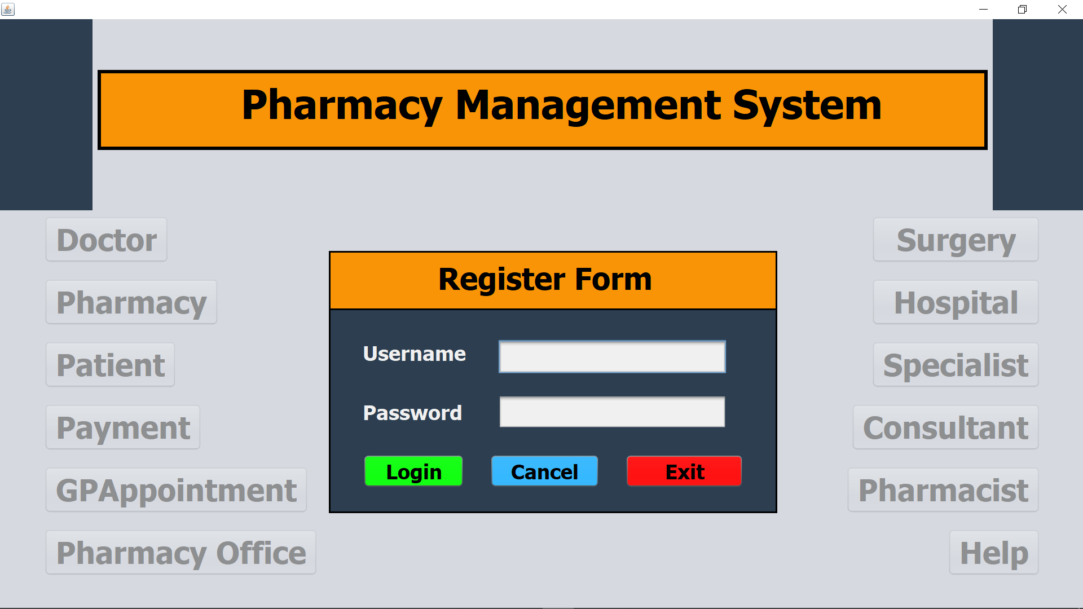
Functionalities
First of all, we have to Login. Because if we do not login first, we will not be able to access any of the internal features of this Application. Looking at the picture below we can see that all the options inside seem to be covered in a fade! All these options are not clickable.
The Home page will look like this before Login!
1

Slide 6
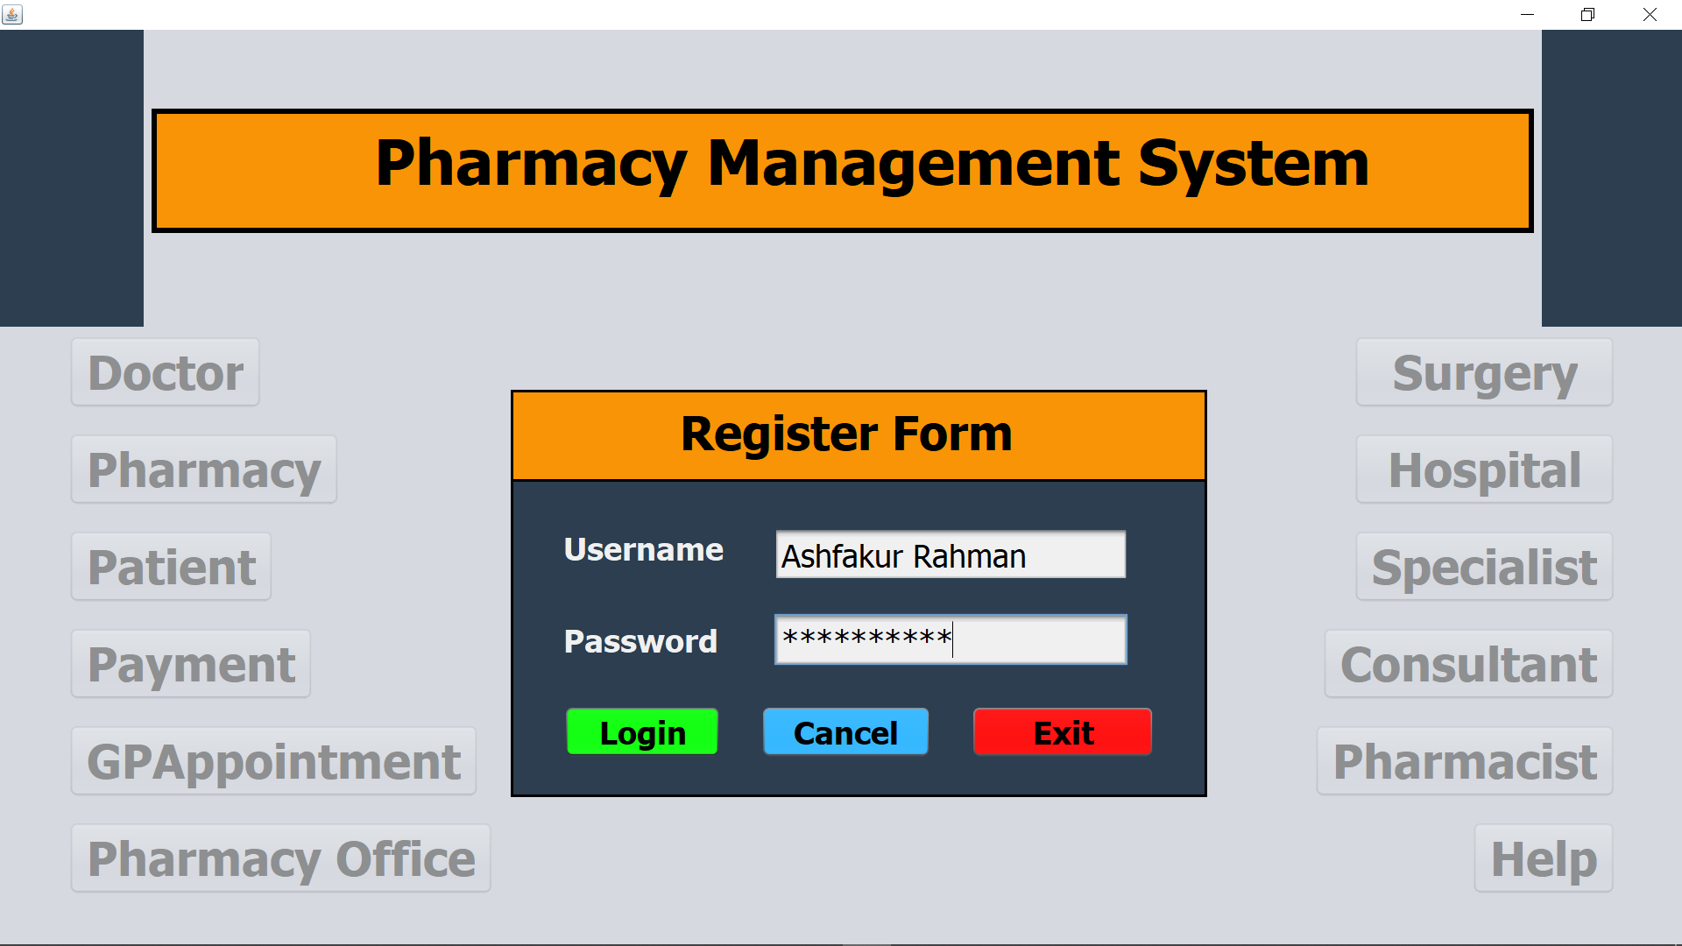
Functionalities
You need to login by entering a valid username and password which is pre-determined. We can see that all the options inside still seem to be covered in a fade because the login is not complete yet.
The Home page will look like this when you Login!
2

Slide 7
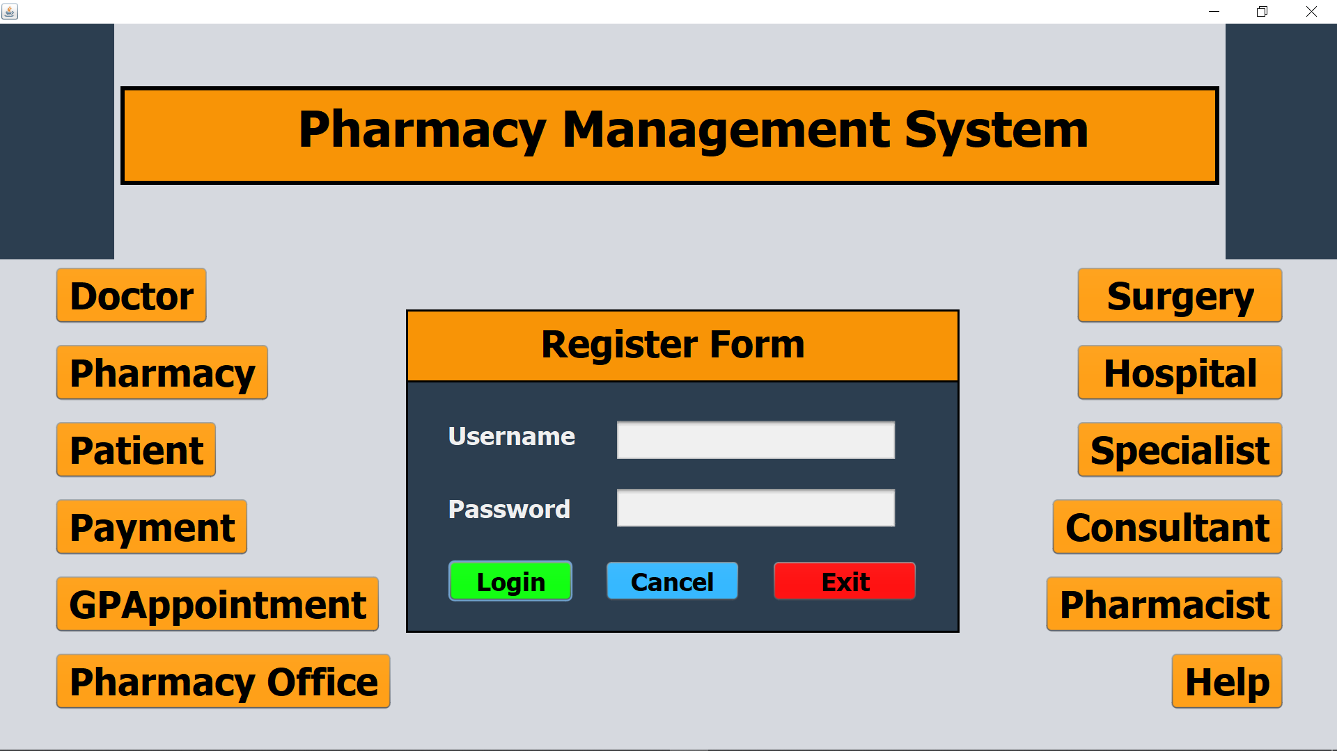
Functionalities
When we have finally successfully logged in, we will see a clear window with many options without fading. This means we can now enjoy the benefits of using any feature we need. Because now all the options are clickable!
The Home page will look like this after Login!
3

Slide 8
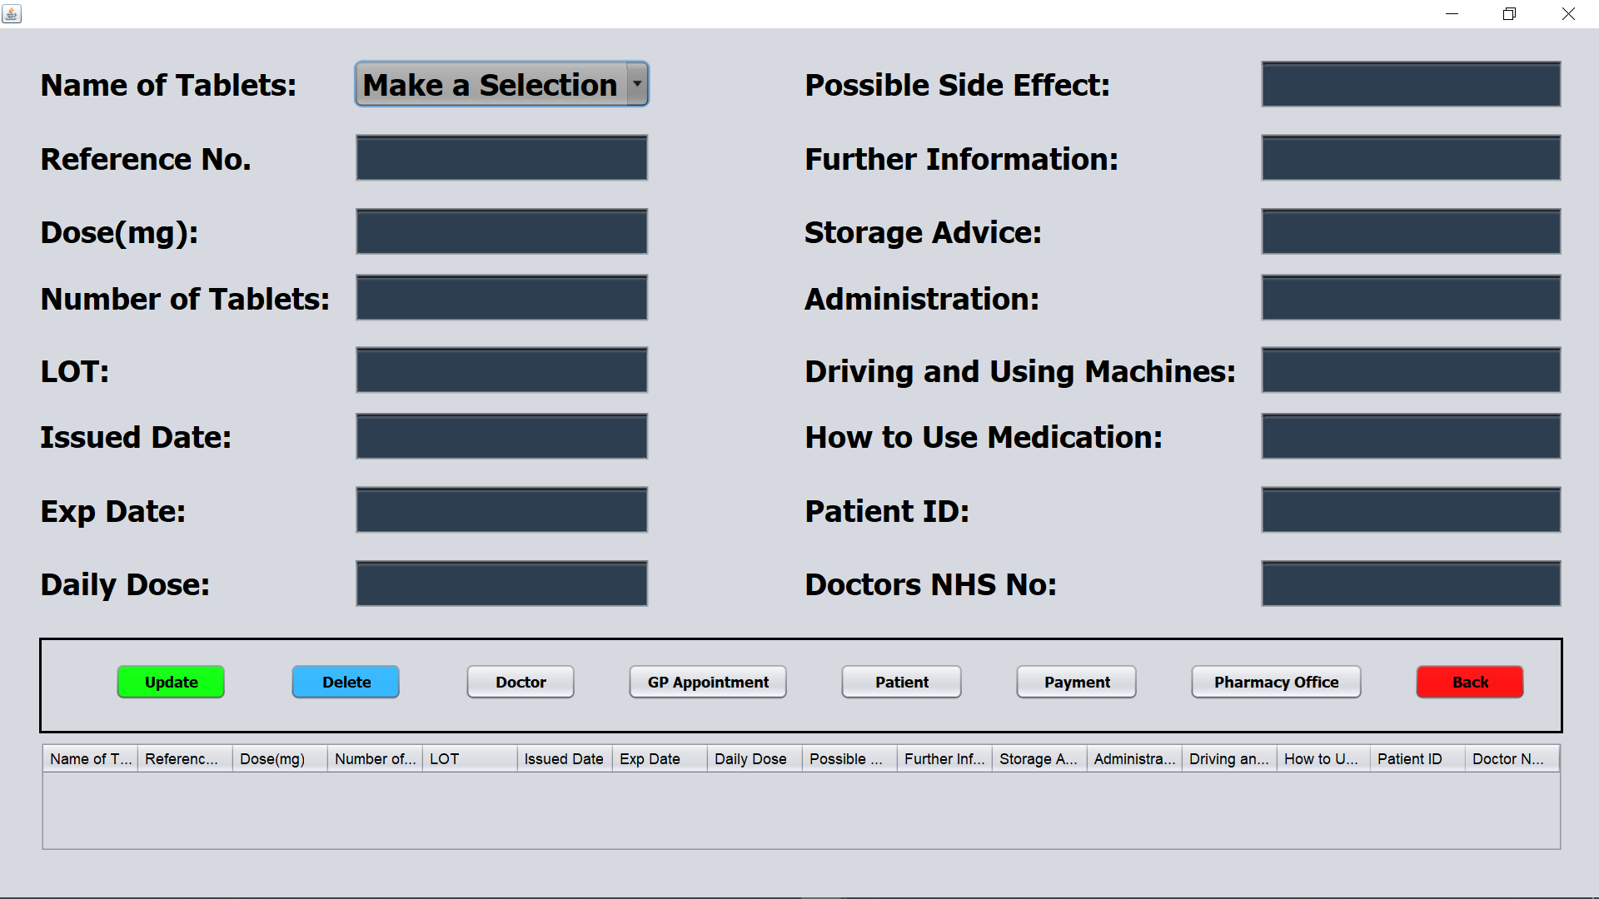
Functionalities
Although there are many options here, we will briefly try to understand the system by clicking on these two buttons, Pharmacy and Doctor. After clicking on the Pharmacy button, we will see an interface like the one below. From here we will select, update and delete the medicine!
After clicking Pharmacy button!
4

Slide 9
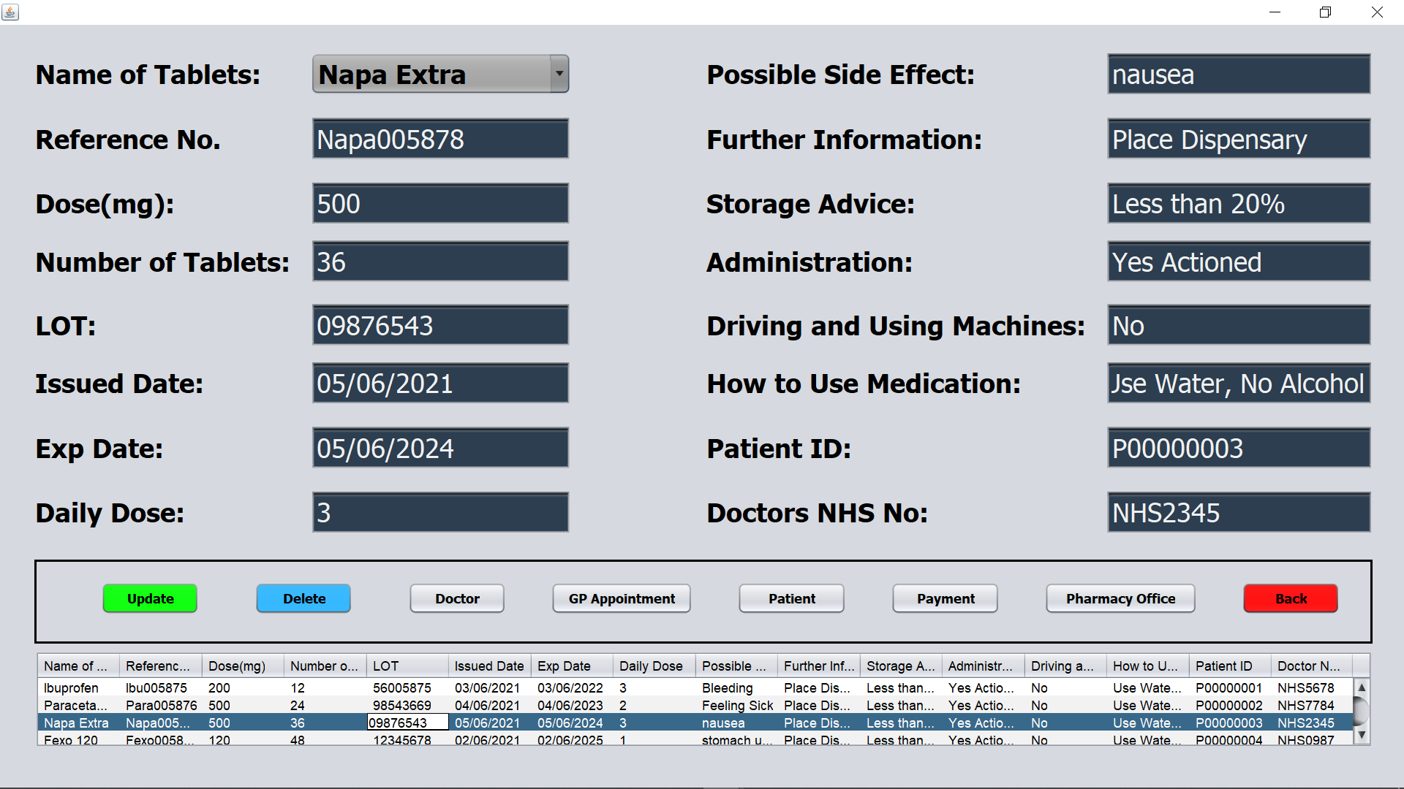
Functionalities
It’s a challenging matter to set the names of millions of medicines here but we have created a demo by storing the names of only a few medicines here like Napa Extra, Paracetamol, Fexo 120 etc. From here we will be able to complete the work of deleting, updating and knowing the drugs and their characteristics!
After selecting a drug like Napa Extra!
5

Slide 10
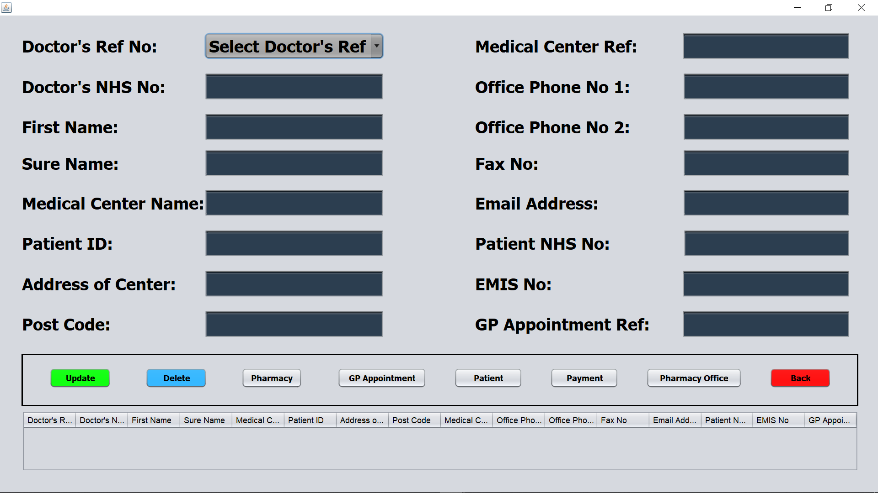
Functionalities
After clicking on the Doctor button like the Pharmacy button we will see an interface like the picture below. From here we will be able to know all the necessary details of the doctor by selecting the reference number of the doctor and will be able to update and delete also!
After clicking Doctor Button!
6

Slide 11
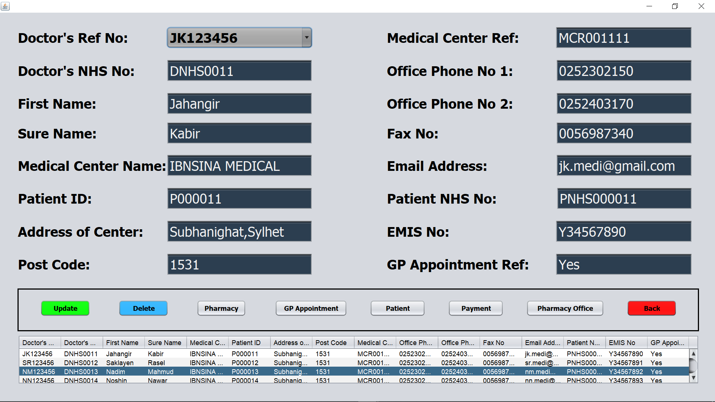
Functionalities
After selecting a doctor reference number, we will see all the essentials of a doctor as shown in the picture below. Although it is very difficult to enter the data of millions of doctors, just to make it easier to understand, here are a few doctors in my project. From here we can also update and delete the data of doctors!
After selecting a Doctor Ref. like JK123456!
7

Slide 12
Conclusion
From the outside of the software called Pharmacy Management System, it is difficult to understand how huge a world can actually possible to create inside it!
Creating a qualified software actually takes years of hard work.
I would like to take this pharmacy management software to another level in the future. That is why I am asking for your help and prayers.

Slide 13

THANK YOU!!

